Slide 1
Ad hoc Networks
hvraman@iiits.in

Slide 2
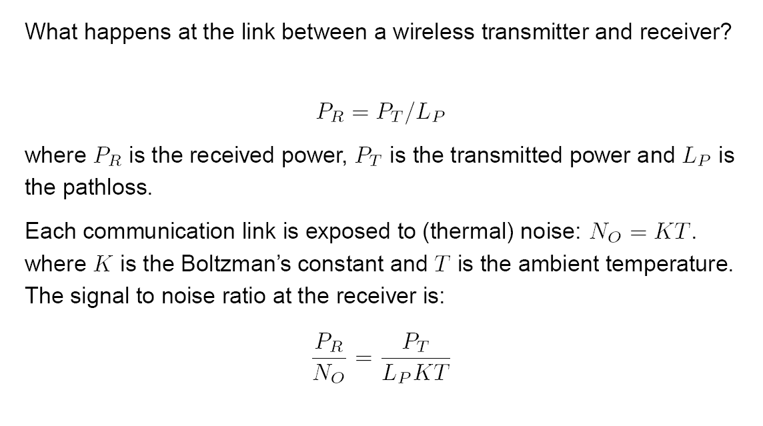
Motivation

Slide 3
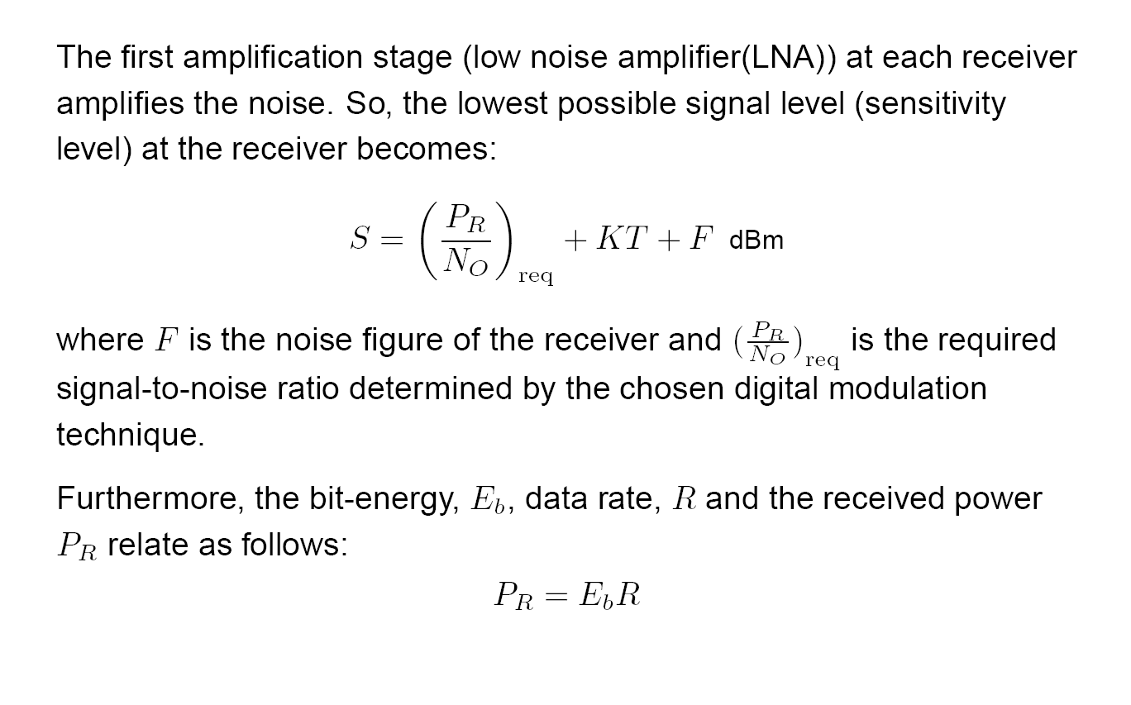

Slide 5
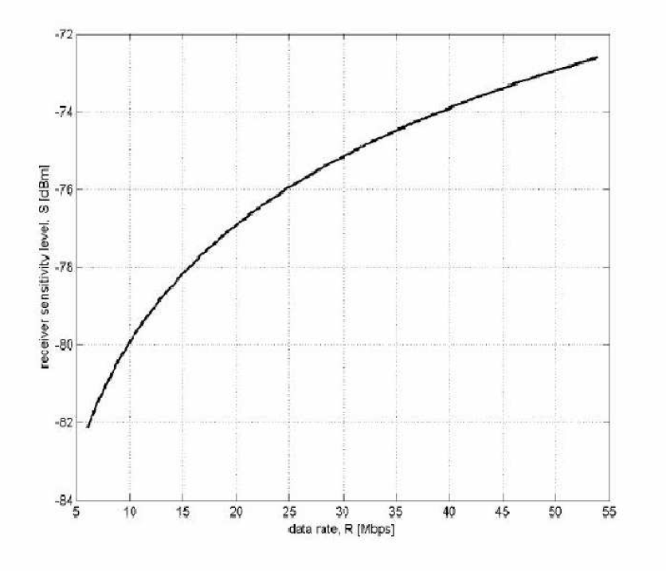

Slide 6
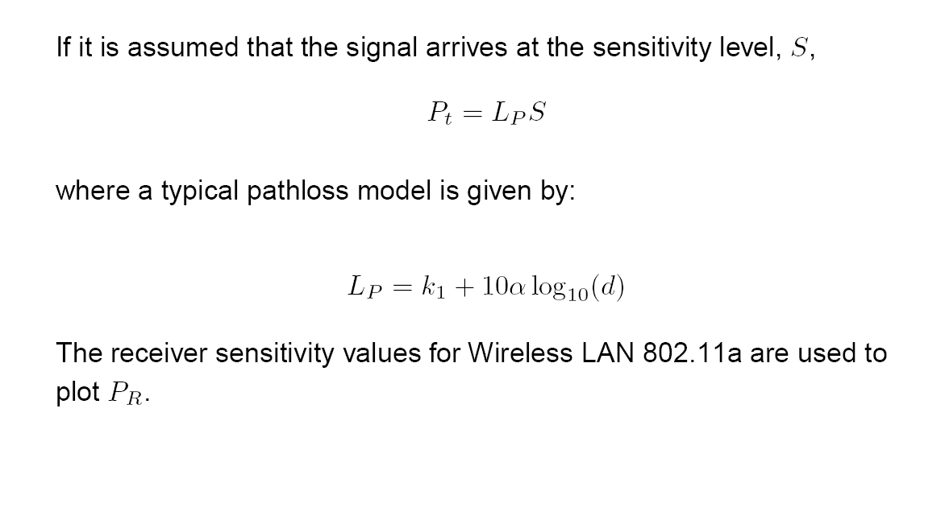

Slide 9
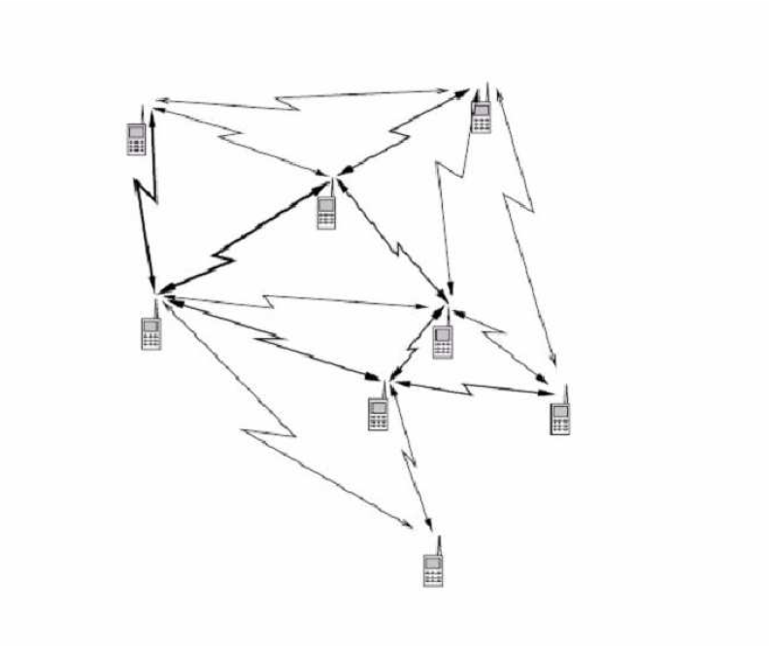
Eg. of Ad hoc Networks

Slide 10
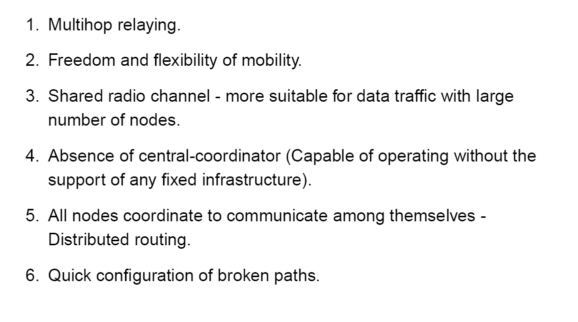
Main Principle

Slide 11
Limitations

